Slide 1
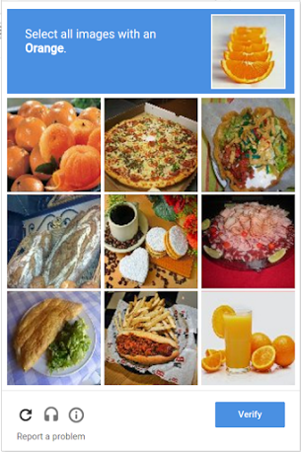
QUICK, SOLVE THIS

Slide 2
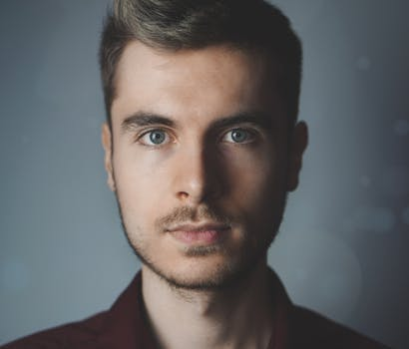
That was easy. Now teach a computer to do it.
Wait, neural nets can do that.
Yep.
Dense neural nets will attempt to learn a dependency between ALL pixels.
Would you expect to have a strong dependency between the two pixels pointed out?
Notes:
Dense neural nets don’t use location information efficiently. There’s a better way…

Slide 3
Convolutional Neural Nets
(also known as CNN)

Slide 4
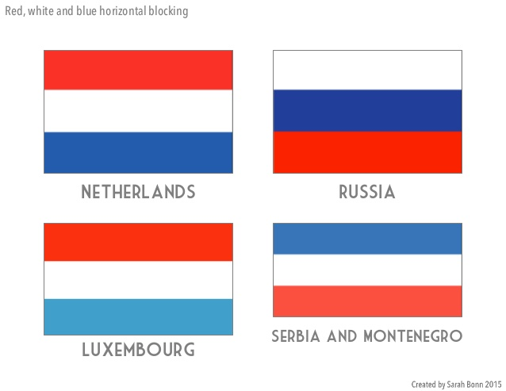
What are they used for?
They handle data where location is important.
Most commonly, images!
We’ll cover image classification and regression here.
Item | Serve Food | Avg. Price | Tasty
Centro | True | 10 | True
MUSC | True | 8 | False
Item | Serve Food | Tasty | Avg. Price
Centro | True | True | 10
MUSC | True | False | 8
Notes:
Top: location of colors IMPORTANT
Bottom: location of colors NOT IMPORTANT

Slide 5
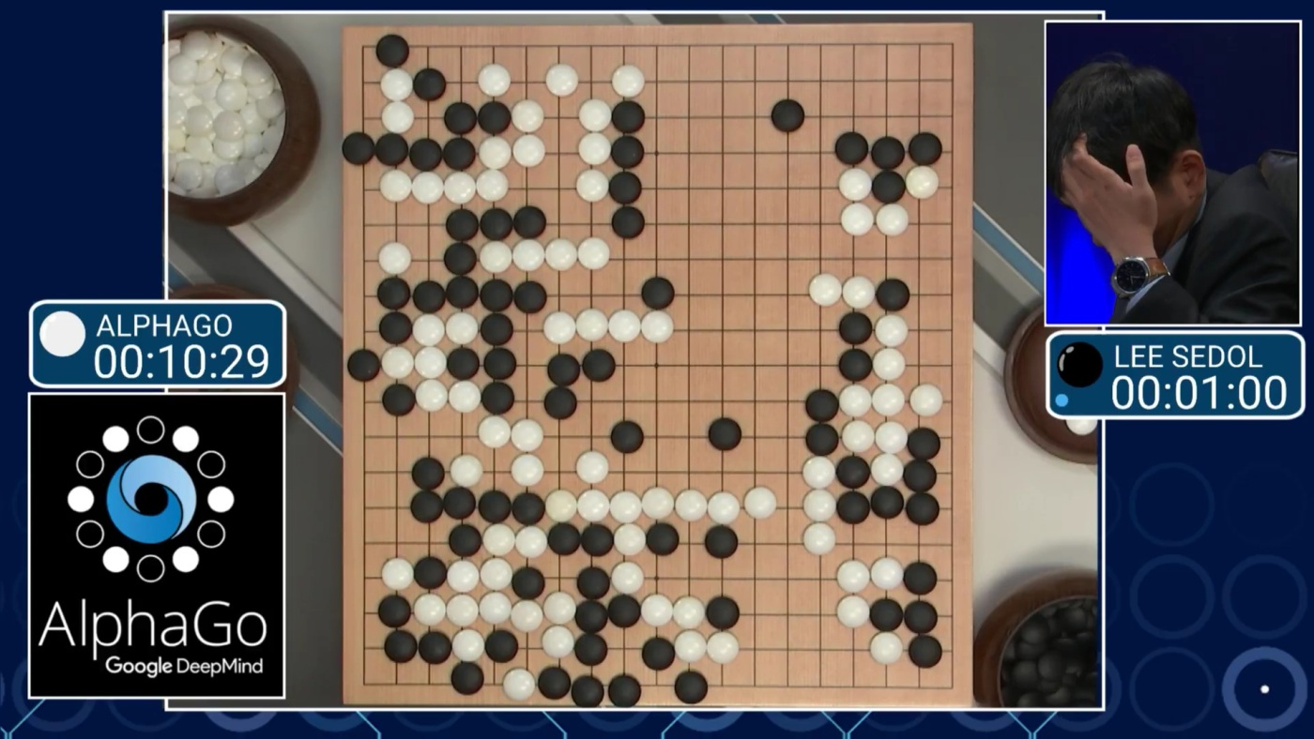
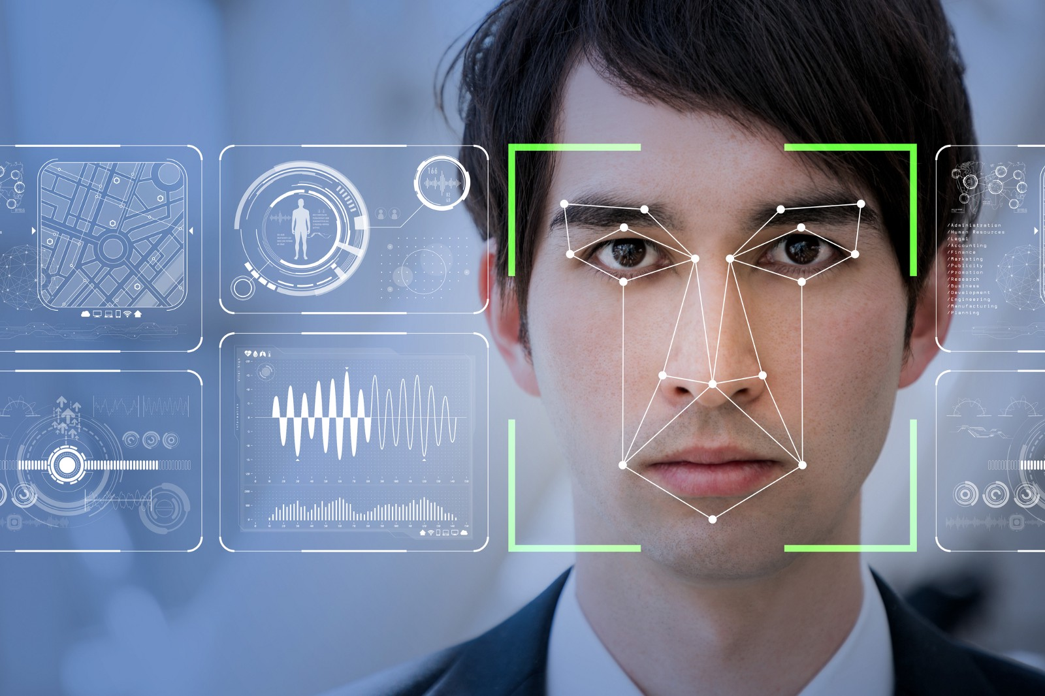
Some Applications of CNNs
Lots of Reinforcement Learning
e.x. AlphaGo
Board games have important spatial information
Also, video games and robotic control
Face Recognition
Pretrained models speed up things significantly
There’s several datasets on Kaggle for this.
Notes:
A lot of things we’d associate with AI in movies would probably be done with architectures involving a CNN.
In this case, a robot plays Go and defeats a high-ranking human with the spatial information being handled by a CNN.
Video games and robotic controls for mechatronics will also have constant video feeds handled by something convolutional.
MNIST is the standard image classification dataset. Try it out!

Slide 6
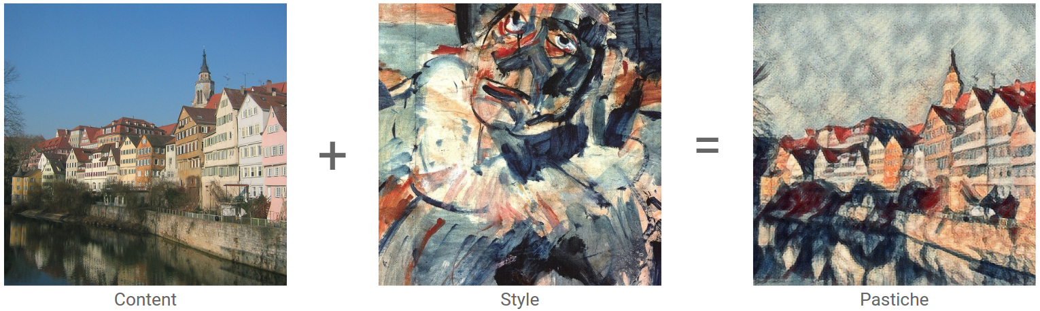
More Applications
Artistic Generation of Images
Artistic style transfer, for example
Notes:
Yes, computers can be creative. Depending on your definition of creative, anyway.

Slide 7
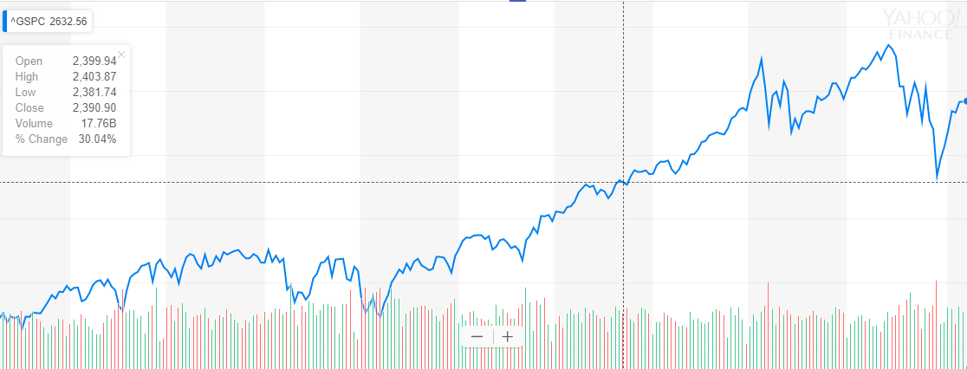
More Applications?
It’s actually ideal for time series data. (1D)
RNNs overfit heavily
“spatial” dependence is pretty similar to “temporal” dependence
Video
Along the same idea as 2D
But, you can add a time-dependent layer or convolve over 3 dimensions

Slide 8
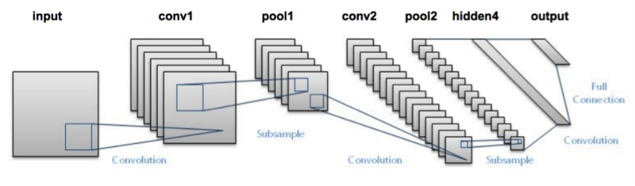
Parts of a CNN
Convolutional Layers (several stacked)
Convolution
Max Pooling
Dense layers and Output Layer

Slide 9
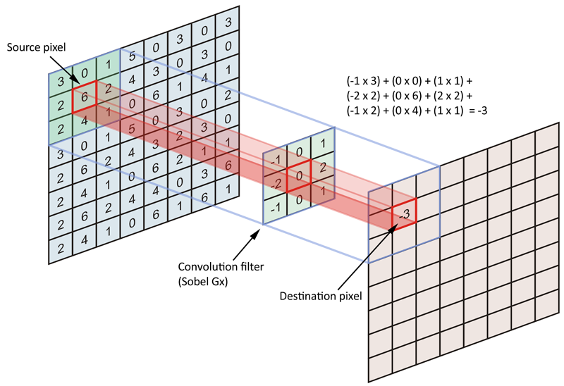
Convolutional Layer: Convolution (Filter)
Filters
A small “box” that looks like a part of the image you want to look for
Multiplying the filter by the part of the image gives us an indication of the amount of similarity the image part has with our filter
So how do we get these filters?
Backpropagation gets us the weights of filters that we need.

Slide 10

Convolutional Layer: Convolution (operation)
Convolution
Dragging this filter across the entire image and saving the “similarity” scores for each filter location.
We apply this process to a lot of filters.
There will be a new “filter image” for every filter.
Parameters: Filter size, number of filters.
Afterwards, apply an activation function to the filter image.
Code:
tf.layers.conv2d (input, filters, ksize, strides)
Conv2D (filters, ksize, strides)

Slide 11
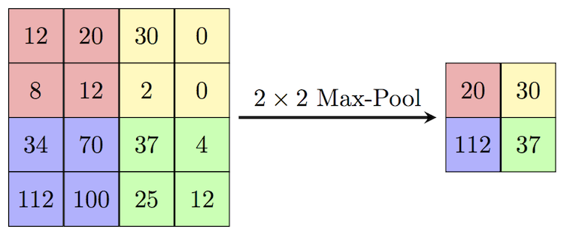
Convolutional Layer: Max/Average Pooling
Take the maximum value of a defined area (defined by pool size).
Move this area across the entire image, in some way indicated by strides.
Do this for each filter image.
Parameters: Pool size, strides
Code:
tf.layers.max_pooling2d(inputs, pool_size, strides)
MaxPooling2D (pool_size, strides)

Slide 12
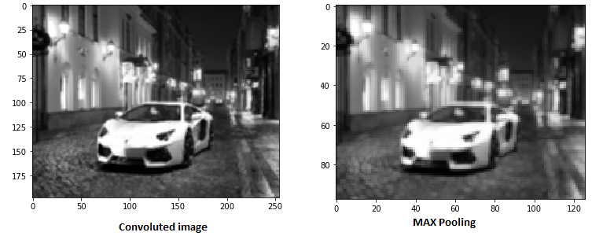
Why Max Pooling?
Location invariance: within each block, it doesn’t matter exactly where the maximum value is.
Downsampling: Max pooling makes a smaller representation of the above, and hopefully retains the same information
Reduction in parameters: The next layer will have to process smaller images.

Slide 13
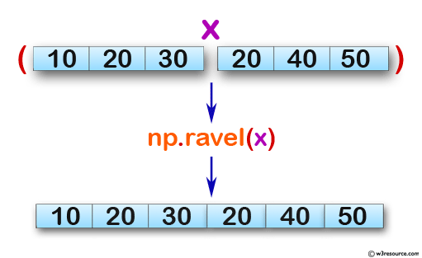
Output Layer
Flatten: Take the 3-dimensional data of your CNN layers and reduce it to one-dimensional data that your dense layer understands
Then, put the result of the flattening into a dense layer to get your overall output.
You can add hidden layers between the CNN and output if you want
Code:
tf.flatten(x)
Flatten()
tf.flatten(x)

Slide 14
Classification
Dense output layer has 1 node per class
Outputs will be in terms of class probability (i.e. how likely is it that that this object belongs to each class?)
The loss function used will be the log-loss
e.x. is this face male or female?
Code (tf):
output = tf.layers.dense(inputs, n_classes, activation=tf.nn.softmax)
loss = tf.reduce_mean( tf.losses.softmax_cross_entropy(…) )
Code (keras):
output = Dense(n_classes)
model.compile(loss = “categorical_crossentropy”)
Notes:
N_classes here should be 2, since there’s 2 options

Slide 15
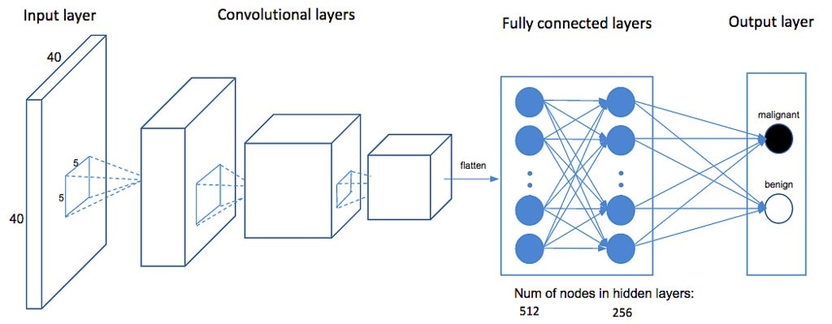
0.97
0.03
Notes:
What would this mean?

Slide 16
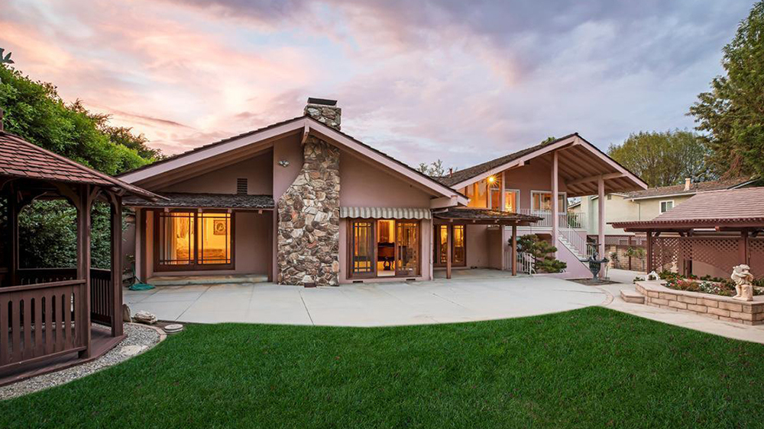
Regression
Dense output layer will have 1 node
The activation function will be linear.
The output will simply be the value.
The loss used will be the mean squared error, mean absolute error, or something similar.
Code (tf):
output = tf.layers.dense(inputs, units = 1)
loss = tf.reduce_mean(tf.square(labels – output))
Code (keras):
output = Dense(1)
e.x. How expensive is this house? (can be any single value)
$2,500,000

Slide 17
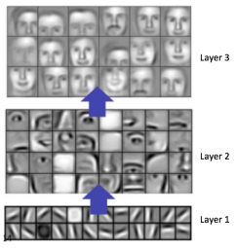
Why does this work?
It mimics animal visual processing systems
Consecutive layers of abstraction
Edges
Shapes
Eyes/nose/mouth/etc
The entire face

